Slide 1
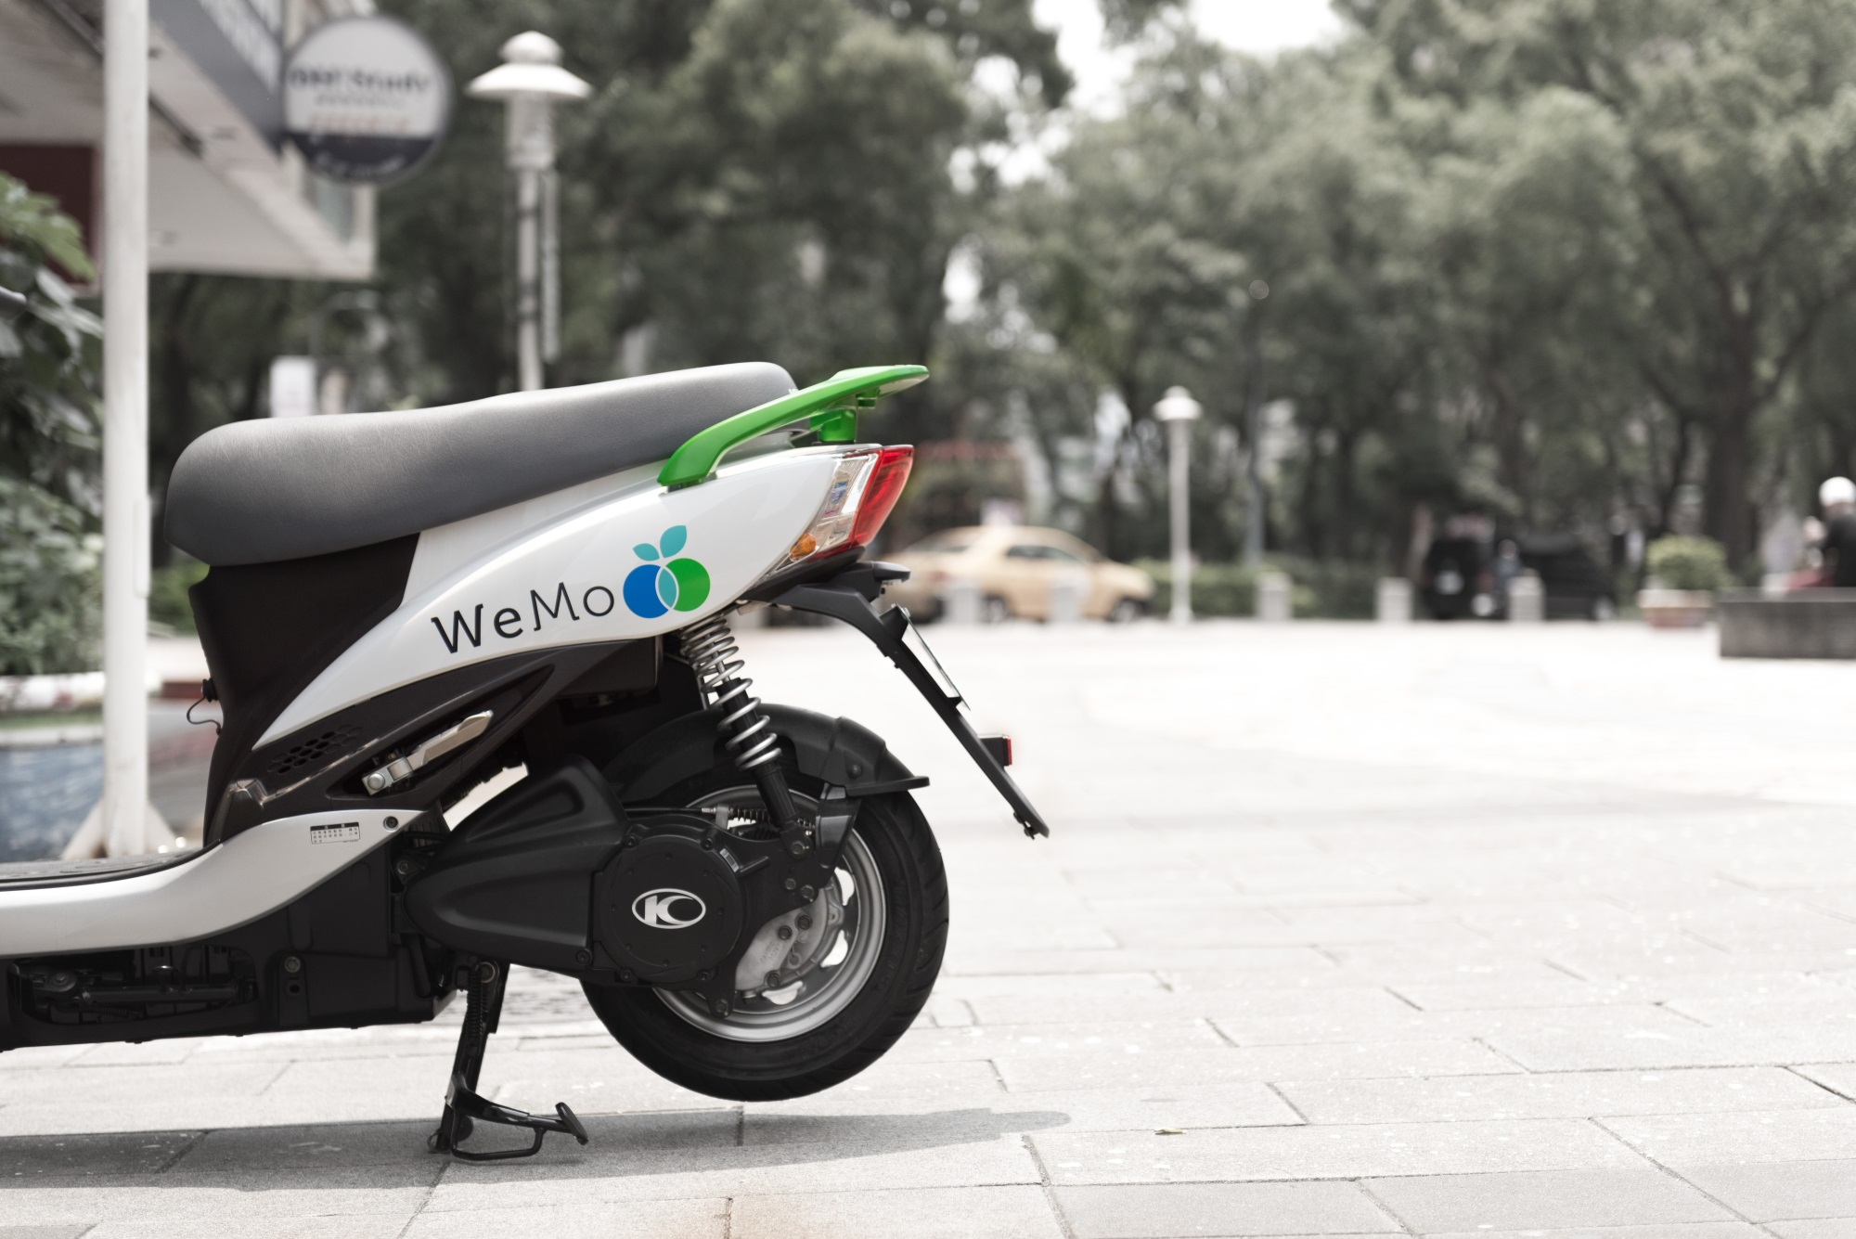

WeMo Scooter
Hsu, Chun-Hui/Chen, Jia-Xin/Yang, Jih-Hao

Slide 2
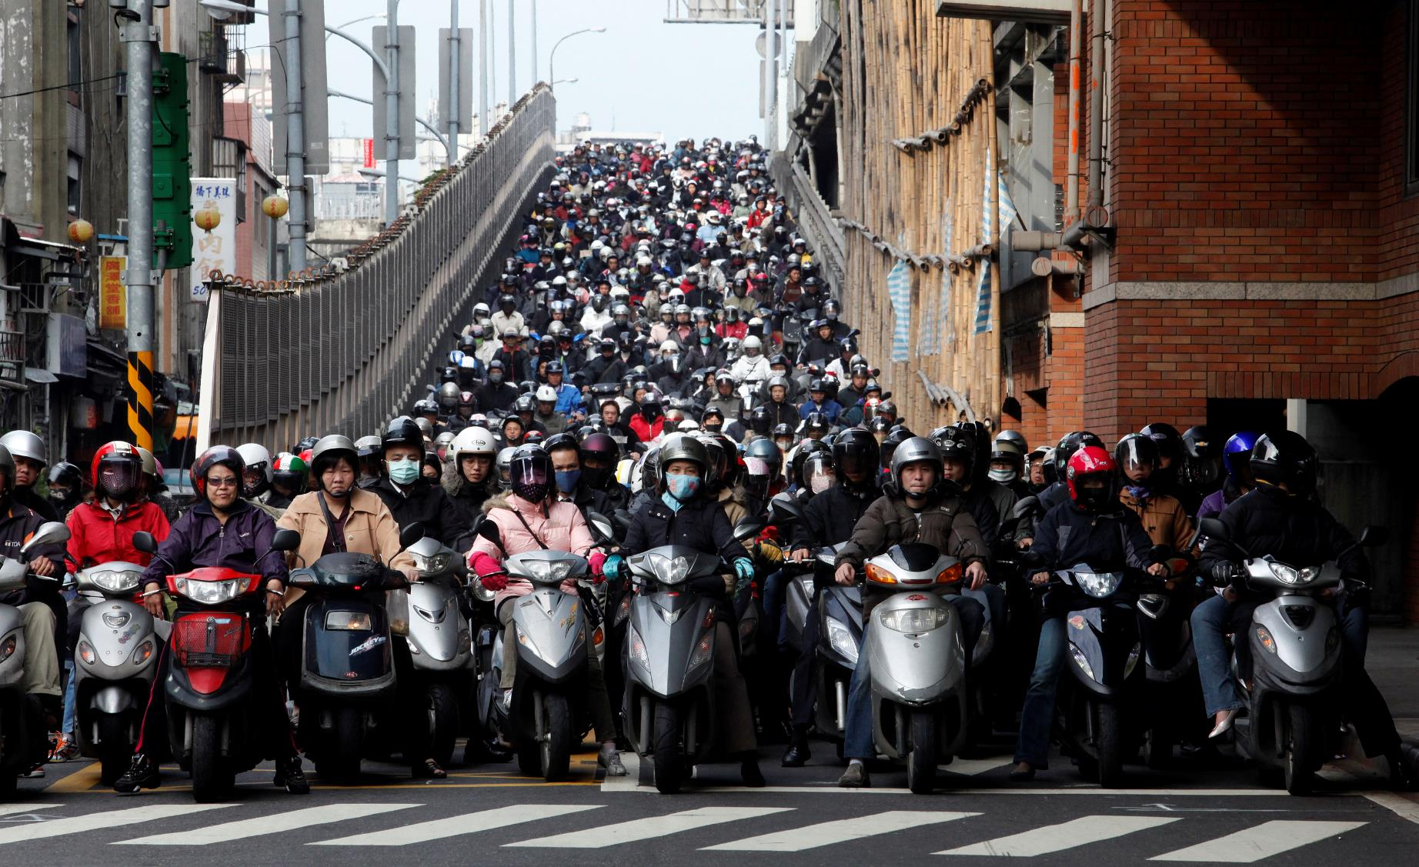

Slide 3
Taiwan‘s pollution problem
15,000,000 up
23,571,990
15 years old up 19,257,198

Slide 4
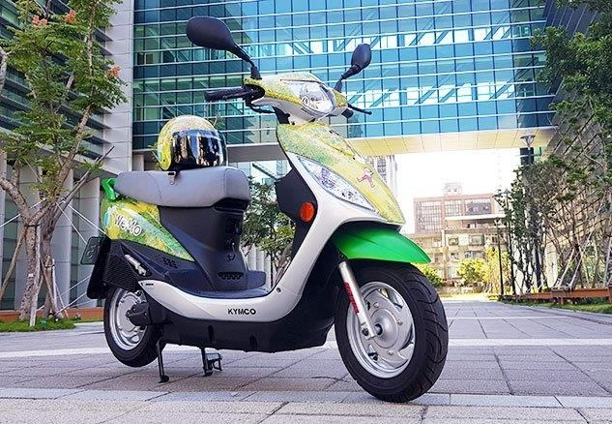
What is WeMo?
A sharing
electric scooter

Slide 5
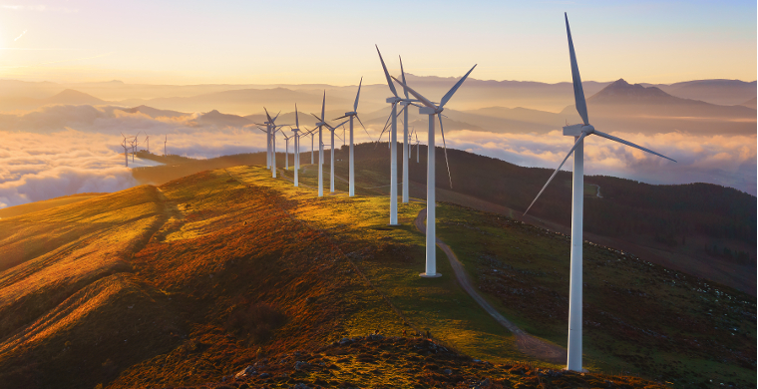
Agenda
Business model
Vison
SWOT analysis
Social impact
Recommendation

Slide 6

Business
Model

Slide 7
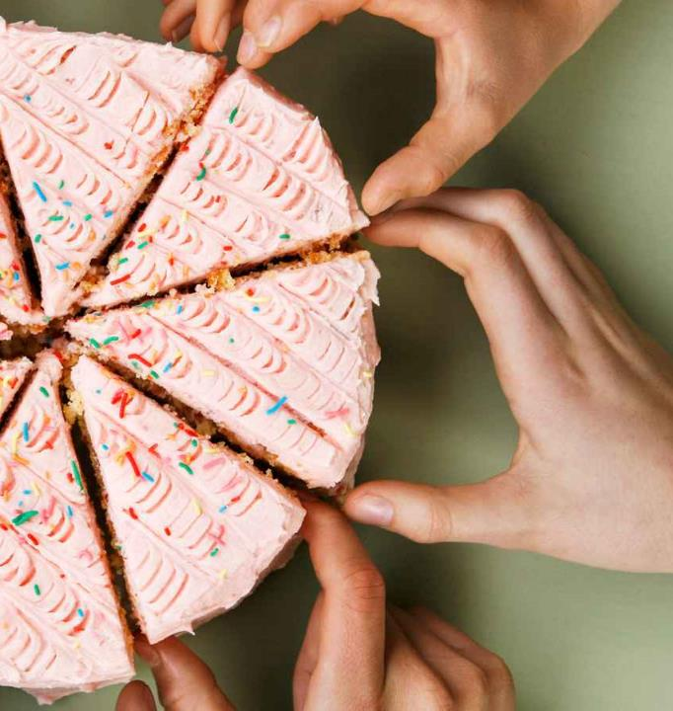
Sharing
Economy
Access
over
Ownership

Slide 8
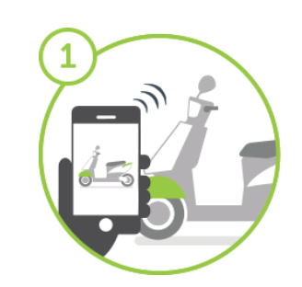
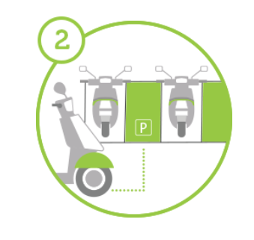
How to Use
Rent & Return
All by your phone
All by your phone
Go wherever you want
legally
Park wherever you want

Slide 9

Fee
General
Youth
plan
plan
NT$ 15
NT$ 9
First
First
/6min
/6min
(USD 50₵)
(USD 30₵)
NT$ 2.5
NT$ 1.5
/min
/min
(USD 8.3₵)
(USD 5₵)
After
After

Slide 10
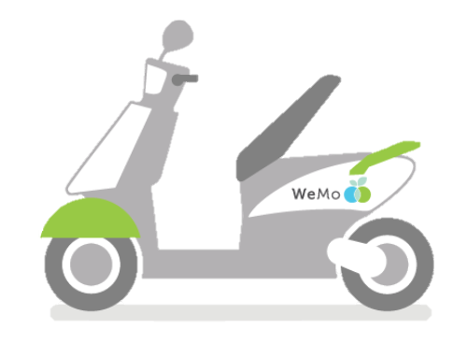

WeMo’s achievement
1st sharing electric scooter in Asia
Over 10,000 members using the service
Roughly 400,000 km total distance ridden

Slide 11
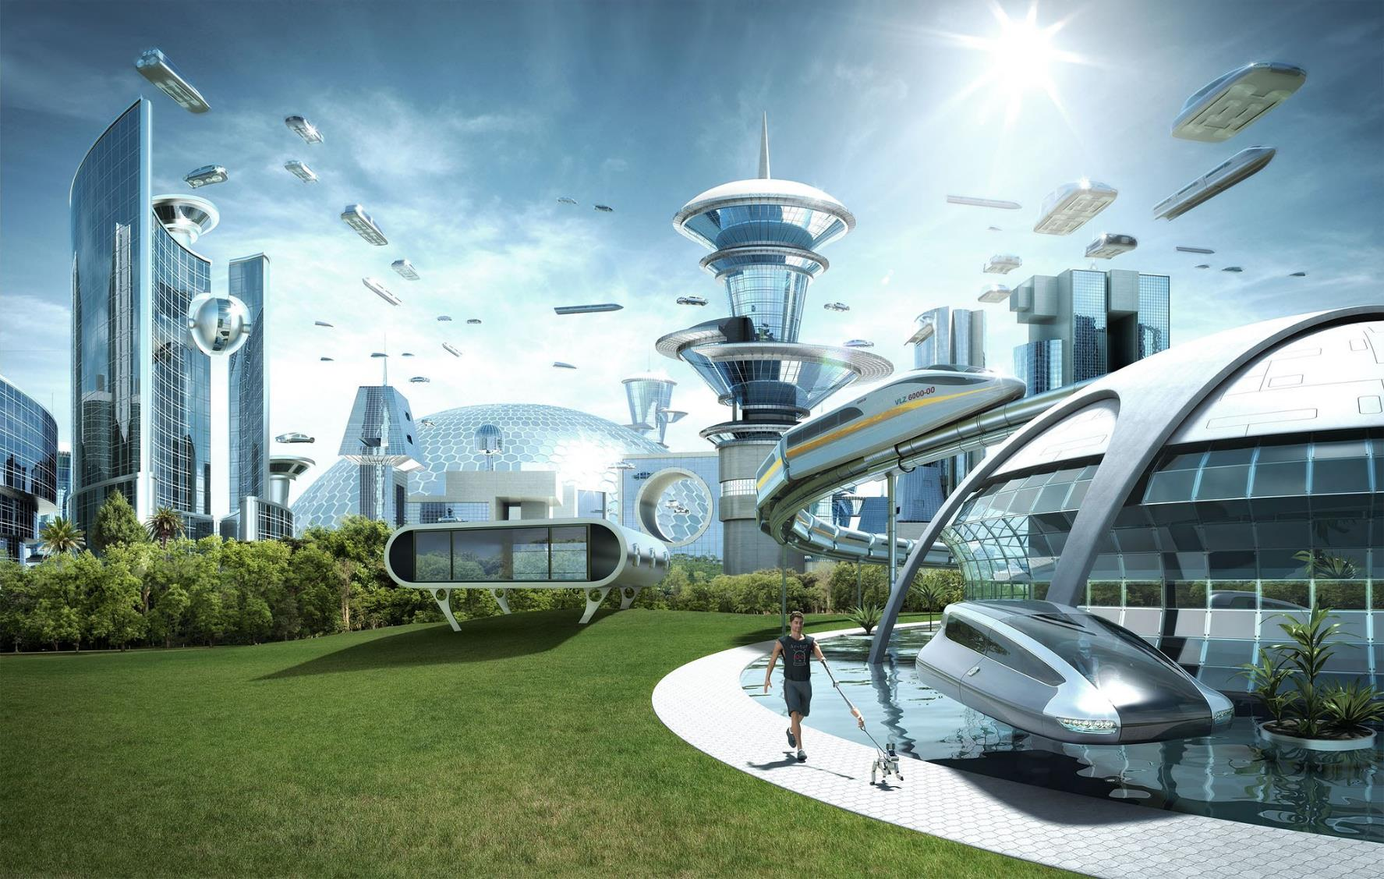
Vision

Slide 12
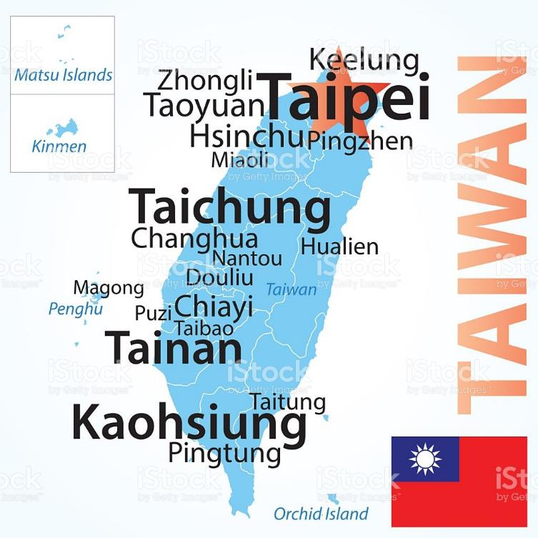
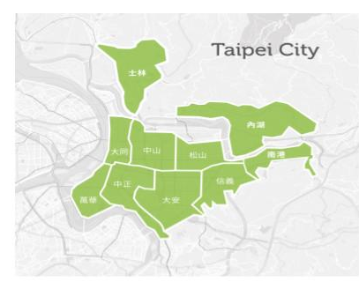

Expand service region to main cities in Taiwan
Whole country
10 districts in Taipei city

Slide 13

SWOT Analysis

Slide 14

1.
Low fee
2.
Ride and return anywhere
3.
Good relationship with the government (3U Plan)
4.
Smart-control device

Slide 15





Charging Standard
1.2 KM
15 mins(on foot)
Taxi
NT$70/8mins
Bus
NT$16/10mins
YouBike
NT$0/12mins
WeMo
NT$15/8mins

Slide 16
1.
Low fee
2.
Ride and return anywhere
3.
Good relationship with the government (3U Plan)
4.
Smart-control device

Slide 17


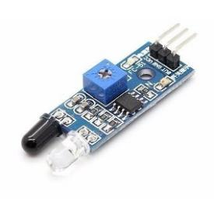
Smart-control Device
GPS
Gyroscope sensor to detect vibration
Sensor to detect air quality

Slide 18

1.
Battery’s power of scooter is not enough
2.
Low awareness
3.
Heavy assets company
4.
High cost of research and development

Slide 19


1.
The rise of going green..
2.
The trend of sharing economy.
3.
Scooters are crucial daily transportation in Taiwan.
4.
There are many successful examples in other countries.

Slide 20

1.
Recharging facility is not enough.
2.
The recharging facility specification will not match the one WeMo is using now.
3.
The concept of the subsidy against to
the idea of WeMo.

Slide 21
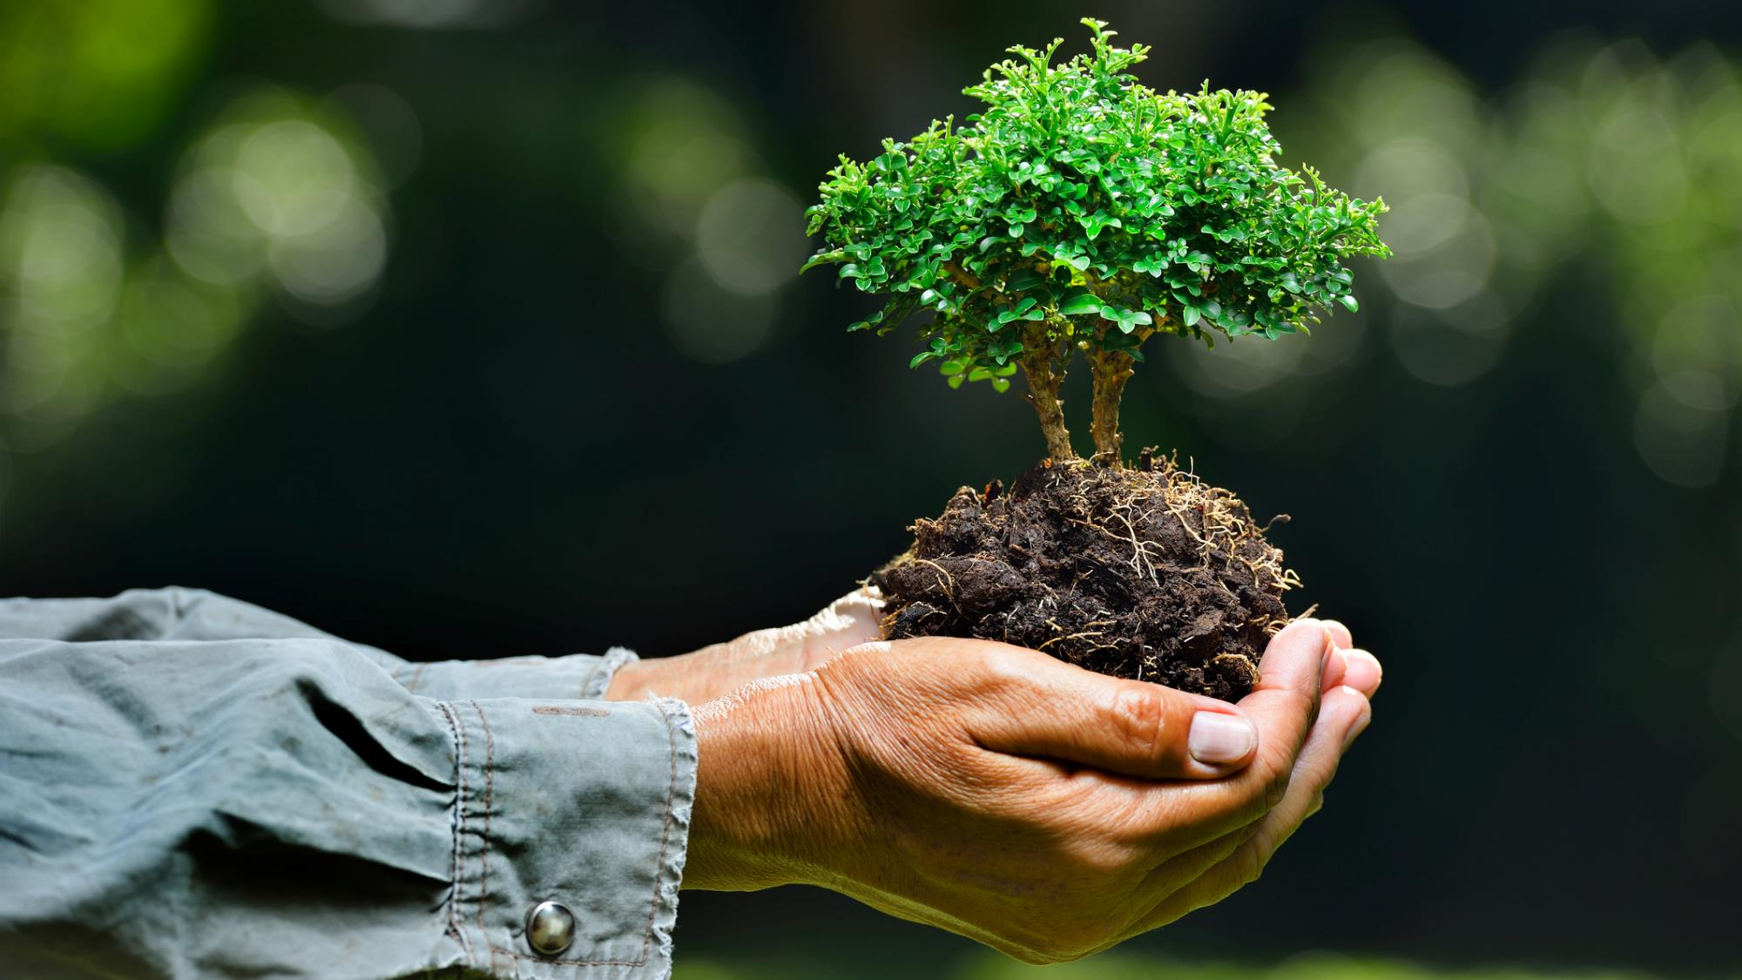
Social Impact

Slide 22
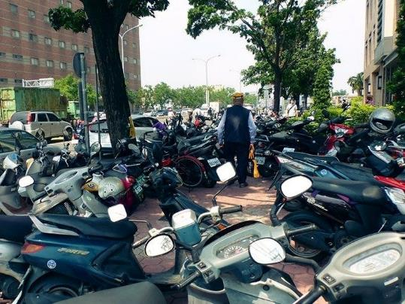

Social Impact
Reduce the number of scooters
Road-smoothing project
1
3
Reduce the air and noise pollution
A new commuting option
2
4

Slide 23
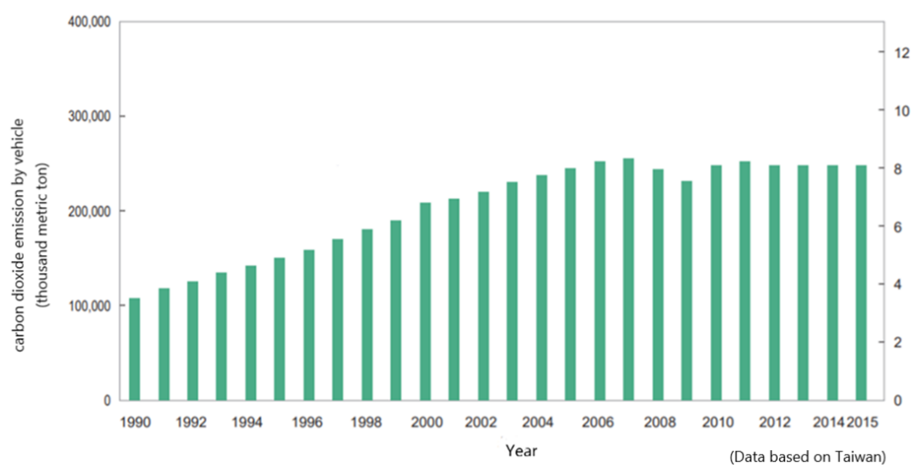
Social Impact
Reduce the number of scooters
Road-smoothing project
1
3
Reduce the air and noise pollution
Provide a new commuting option
2
4

Slide 24
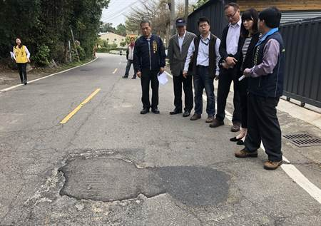
Social Impact
Reduce the number of scooters
Road-smoothing project
1
3
Reduce the air and noise pollution
Provide a new commuting option
2
4

Slide 25

Social Impact
Reduce the number of scooters
Road-smoothing project
1
3
Reduce the air and noise pollution
Provide a new commuting option
2
4

Slide 26

Recommendation

Slide 27


Cooperate with Gogoro (Taiwan electric scooter manufacturer) for the longer battery life.
Lobbying the government to lead the rise of going green.

Slide 28
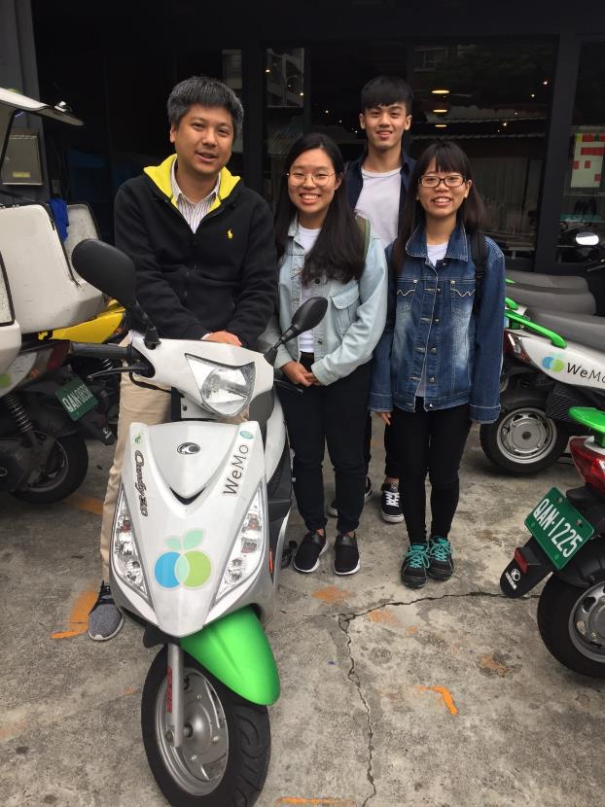

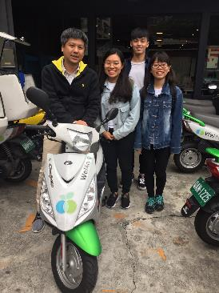
Resources
Internet
Interview

Slide 29
Thank you for your attention

